Slide 1
CS 31006: Computer Networks – The Internet Transport Protocols

Slide 2
Transmission Control Protocol (TCP)
TCP was specifically designed to provide a reliable, end-to-end byte stream over an unreliable internetwork.
Internetwork – different parts may have widely different topologies, bandwidths, delays, packet sizes and other parameters
TCP dynamically adapts to properties of the internetwork and is robust in the face of many kinds of failures.
RFC 793 (September 1981) – Base protocol
RFC 1122 (clarifications and bug fixes), RFC 1323 (High performance), RFC 2018 (SACK), RFC 2581 (Congestion Control), RFC 3168 (Explicit Congestion Notification)

Slide 3
TCP Service Model
All TCP connections are full-duplex and point-to-point. TCP does not support multicasting or broadcasting.
Uses Sockets to define an end-to-end connection (Source IP, Source Port, Source Initial Sequence Number, Destination IP, Destination Port, Destination Initial Sequence Number)
Unix Model of Socket Implementation:
A single daemon process, called Internet Daemon (inetd) runs all the times at different well known ports, and wait for the first incoming connection
When a first incoming connection comes, inetd forks a new process and starts the corresponding daemon (for example httpd at port 80, ftpd at port 21 etc.)

Slide 4
TCP Service Model
A TCP connection is a byte stream, not a message stream
Message boundaries are not preserved end-to-end
These two points go pretty much hand in hand. Since the TCP is a Byte-oriented Connection instead of a Packet-based protocol, each byte of the send data has its own identifying sequence number which distinguishes it from the other bytes of data. Moreover, the data transfer also occurs as a byte stream, which is why it is intuitive to understand that the message boundaries will not be preserved. The application of the sending side writes the data into the sending buffer of the transport layer and the transport layer makes the “segments” and sends them to the destination machine with the help of the network and bottom layers after attaching apt sequence numbers. When the receive buffer of the destination machine is filled with this data from the network layer there, the bytes are just filled into the buffer in the way they are received and are identified with the help of the sequence numbers. When the application side of the destination makes a read() call on the receive buffer, it is provided with whatever number of bytes have been requested and hence there is no notion of a segment or message boundary on the destination side.
Example:
The sending process does 4- 512 byte writes to a TCP stream – for write() call to the TCP socket
These data may be delivered as – four 512 byte chunks, two 1024 byte chunks, one 2048 byte chunk or some other way
There is no way for the receiver to detect the unit(s) in which the data were written by the sending process.

Slide 5
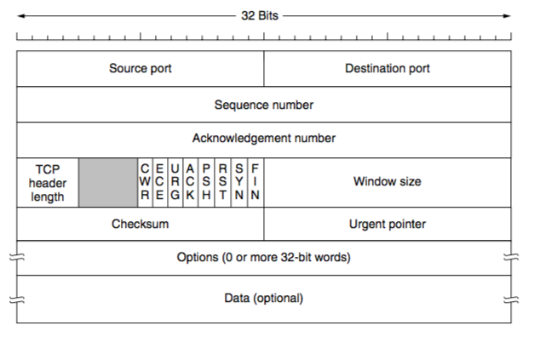
The TCP Protocol – The Header
Source: Computer Networks (5th Edition) by Tanenbaum, Wetherell

Slide 6
TCP Sequence Number and Acknowledgement Number
32 bits sequence number and acknowledgement number
Every byte on a TCP connection has its own 32 bit sequence number – a byte stream oriented connection
TCP uses sliding window based flow control – the acknowledgement number contains next expected byte in order, which acknowledges the cumulative bytes that has been received by the receiver.
ACK number 31245 means that the receiver has correctly received up to 31244 bytes and expecting for byte 31245

Slide 7
TCP Segments
The sending and receiving TCP entities exchange data in the form of segments.
A TCP segment consists of a fixed 20 byte header (plus an optional part) followed by zero or more data bytes.
TCP can accumulate data from several write() calls into one segment, or split data from one write() into multiple segments
A segment size is restricted by two parameters
IP Payload (65515 bytes) : the IP Header mein length ka field is of type SHORT, which implies this upper limit
Maximum Transmission Unit (MTU) of the link : at a single go, max amt of data that can be sent ? apparently a data link layer terminology, where since between each router the link maybe of a different type : WiFi, Ethernet etc , the link capacity determines this factor MAX FLOW is MIN CUT Type ka Fundae maybe I guess pata nahi

Slide 8
How a TCP Segment is Created
Write() calls from the applications write data to the TCP sender buffer.
sender maintains a dynamic window size based on ( flow and congestion control ) Send(rate) = min( NetRate, RecvRate ) :: SendWSize = min( NetWSize, RecvWSize) . This analogy can be basically drawn from the fact that more the window size, more the number of bytes that can be send together and hence more the sending rate. The Congestion Control Additive Increase increases the rate by increasing the window size and then as congestion is detected, it Multiplicatively Decreases the rate and then the Additive Increase starts again. The Received Advertised Receive Capacity at the ACKs received ( each ACK has the current RecvWSize Advertised ) is also a factor in determining the Window Size . This is how the window size at the sender side is dynamically maintained.

Slide 9
How a TCP Segment is Created
Modern implementations of TCP uses path MTU discovery to determine the MTU of the end-to-end path (uses ICMP), and sets up the Maximum Segment Size (MSS) during connection establishment
May depend on other parameters (buffer implementation).
So this is basically like poora path ko scan karo and find out what is the minimum MTU supported by the various links in the path. This can be done by the ICMP Protocol ( jaise Assgn mein HOPS ka data nikale the, yahan MTU nikal sakte ). So after exchanging this information at the network layer and getting the feedback, the MSS is set accordingly.
Check the sender window after receiving an ACK.( each ACK has the current RecvWSize Advertised ) If the window size is less than MSS, construct a single segment; otherwise construct multiple segments, each equals to the MSS
Amount of data in the sender buffer. The amount of data is the sender buffer also plays a role, if the amount of data is fairly less as compared to the maximum segment size, at times it is senseless to keep that data in waiting for the remaining data to come so that a full segment can be sent. ( much like the Auto conundrum back in Chetla lolz ). So if the application is not generating enough data, at times we may need to push a small segment into the Network.

Slide 10
Challenges in TCP Design
Segments are constructed dynamically, so retransmissions do not guarantee the retransmission of the same data segment – a retransmission may contain additional data or less data This is in sync with the ‘messages are boundary-less’ bandwagon. The TCP only knows which “Bytes” are UnACKed as of now and hence during the retransmission it simply creates a Segment of the UnACKed Bytes and sends the Segment over the Network to the Destination. In what way the Segment was send earlier and what fraction of the recently sent segment is actually needed for retransmission is not known. Due to this there is a high chance for extra data ( already received bytes ) to reach the Destination , which in turn might cause ALL the required data not to reach the Destination as well.
Segments may arrive out-of-order. TCP receiver should handle out-of-order segments in a proper way, so that data wastage is minimized. This is typical of the Network Layer because due to the different Routing Protocols and the Load Balancing reasons many a time segments are sent on different paths/routes to the Destination and hence may reach out of order. The Buffers at both the sides are FIFO but the Networks sadly is not, and hence this out of order receive should also be taken care of in a proper manner as simply rejecting the Out of Order Segments ( which are in the Receiver Side Window ) will lead to a drastic drop in the Network Performance and Throughput. See 19:: 31:00 .

Slide 11
Window Size field in the TCP Segment Header
Flow control in TCP is handled using a variable sized sliding window.
The window size field tells how many bytes the receiver can receive based on the current free size at its buffer space.
What is meant by window size 0? No particular special meaning, it simply means that the space in the receive buffer is insufficient and hence the Sender side should stall transmitting any segments to the Destination Side until there is a appreciable amount of space available in the receive buffer of the Destination Application, which the Receiver Side shall advertise.
TCP Acknowledgement – combination of acknowledgement number and window size

Slide 12
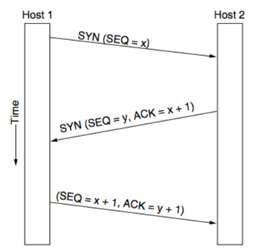
TCP Connection Establishment
How to choose the initial sequence number?
Protect delayed duplicates, do now generate the initial sequence number for every connection from 0
Original implementation of TCP used a clock based approach: the clock ticked every 4 microseconds (ticked as in increment to next value), the value of the clock cycles from 0 to 2³²-1. The value of the clock gives the initial sequence number
This basically ensures that even if a connection gets crashed, the clock shall keep ticking and when the connection is re initiated, the sequence number from the clock shall have a value which is greater than the value of all the probable numbers which were in use by the previous connection i.e. the forbidden region of the previous connection.

Slide 13
TCP Connection Establishment
TCP SYN flood attack_V0
A Problem with this approach of generation of sequence numbers is that the sequence numbers to be generated are kind of deterministic in nature in the sense that since the clock ticks at a regular interval if we have enough information about the rate of clock ticks and the previous sequence numbers, we can estimate the future sequence numbers. How is that a problem ? Apparently, this renders the Receiver Side susceptible to SYN FLOOD ATTACK, whereby an attacker after determining the Initial Sequence Number which the Receiver(Server) is expecting, generates continuous multitudes of spurious SYN PACKETS. The Server thinks that these are genuine connections and is kept busy in giving out ACKs to these connections, and hence no DATA Segments can be transmitted. This results in the attacker inducing a SYN-Overload or SYN-FLOOD at the Server Side and causing a Denial of Service to the other genuine connections. Little Confusing, How exactly will Server get blocked by some Attacker ka Jaali SYN Packets to it ? I guess it will be something like this that ek particular tuple of {SP,SIP,DIP,DP} ke beech ka connection BLOCK ho jayega if its identifying SN gets taken by some Attacker( possibly this attacker is a virus in the SIP Machine, or can replicate the SP,SIP tuple from the connection on its side). So in this way the attacker can block the server for the client by preempting its connection initiation sequence numbers and thereby prevents connection from taking place
Solution: Use cryptographic function to generate sequence numbers. For the initial sequence numbers for the next connection, what we do is that we use the clock generated value and then generate a cryptographic hash of that value which is greater than it and set that as the Initial Sequence Number. This prevents the SYN-FLOOD attack since the Cryptographic Hash will not be known to the Attacker and hence the value can not be predicted.

Slide 14
TCP Connection Establishment
TCP SYN flood attack_V1 (Kurose Ross 257)
A Problem with this approach of generation of sequence numbers is that the sequence numbers to be generated are kind of deterministic in nature in the sense that since the clock ticks at a regular interval if we have enough information about the rate of clock ticks and the previous sequence numbers, we can estimate the future sequence numbers. How is that a problem ? Apparently, this renders the Receiver Side susceptible to SYN FLOOD ATTACK. What exactly is it ? Flooding is a network terminology which loosely means that packets are broadcasted/received in BULK.
An attacker let us say intercepts packets which are meant from one source to a particular destination, and therefore gathers the details of the UID of the connection, i.e. the { SSN, SP, SIP, DIP, DP, DSN }. It then spoofs the SSN,SP, SIP and sends spurious SYN Packets to the Server. The Server thinking these are legitimate packets, sends an ACK and waits for the ACK back, which the attacker does not actually send. In this way, the attacker floods the server with syn and since the amount of resources on the server side are also limited, this binding of resources catering to each connection may exhaust the pool and this would result in a DENIAL of SERVICE to other genuine connections.
Solution: Use cryptographic function to generate sequence numbers. The client and the server during Connection Establishment can share some information which allows them to use locally secret keys along with a cryptographic hash function which encrypts the sequence numbers which are on the packets in such a way that even if the packets are intercepted and the sequence numbers are leaked, the actual SSN or DSN will be unknown to the attacker since the knowledge about both the cryptographic hash AND the locally secret keys are confined to the CLIENT-SERVER Pair.

Slide 15
TCP Connection Release

Slide 16
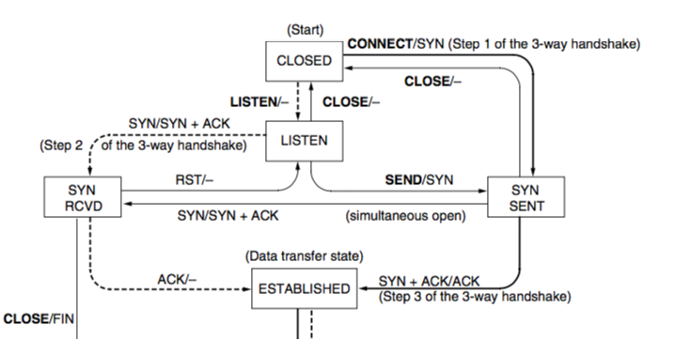
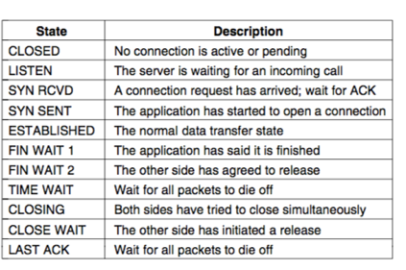
TCP State Transition Diagram – Connection Modeling
Event/Action
Dashed : Server
Solid : Client

Slide 17
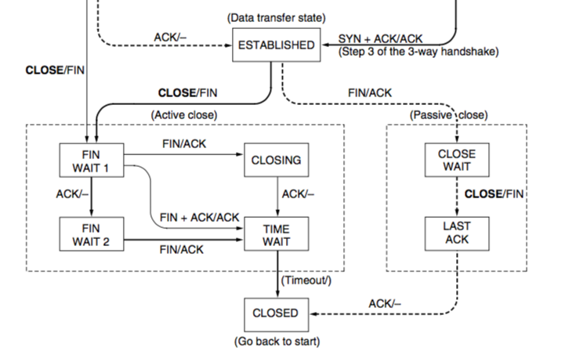
TCP State Transition Diagram – Connection Modeling
The Side which initiates the close is in the ACTIVE CLOSE state, and the one which receives the connection release request is in PASSIVE CLOSE.
In PASSIVE CLOSE, side A gets to know that side B has nothing more to offer and will release the connection after receiving the ACK from it. Moreover, if it receives the ACK of its own FIN, this means that side A has already closed its connection and has allowed B to do so too, so it simply closes off.
In ACTIVE close, there is a need to wait even after sending out the final ACK, so as to let all the packets in the network die, there might be valid packets roaming around perhaps. This also takes care in a way that the ACK which was sent to A was not lost lest we would have received another FIN from B.

Slide 18
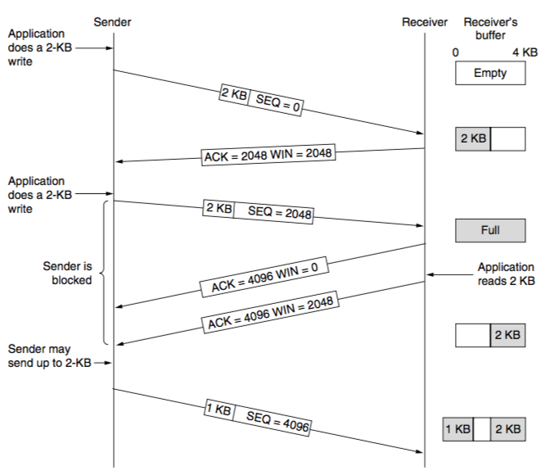
TCP Sliding Window
The Application performs a write on to the sender side buffer, and the buffer holds the data until all of it has been ACKed. In case any bytes’ ACK is lost, the sender side retransmits the necessary packet.
The Receiver Side on accepting a TCP Packet sends the ACK for the apt SeqNum and advertises the available space on the RecvBuffer ( or a value less than it maybe? ) . When the App at the Receiver Side does a recv() and actually reads data from the buffer thereby shifting the window, it can send another packet with the respective ACK and a different Window Size now. The Sender Side shall consider this ACK to be the latest ACK( in case it has not already sent a packet for that SeqNum) and this WSize Advertised to be the one to take into consideration.

Slide 19
Delayed Acknowledgements
Consider a telnet connection, that reacts on every keystroke.
In the worst case, whenever a character arrives at the sending TCP entity, TCP creates a 21 byte TCP segment, 20 bytes of header and 1 byte of data. Add to that the IP Header of 20 bytes(min) and we get 41 bytes for the packet and 1 byte of data. There will be a 40 byte ACK for it as well as a 40 byte Window Size Advertisement perhaps, along with a 41 byte local echoing at receiver side. 162 Bytes of Data in the Network per 1 Byte of Actual Value is too much of an overhead leading to terrible bandwidth utilization.
There is a need to reduce this overhead, since in Networks with sparse bandwidth allowances, bandwidth needs to be managed properly. We can maybe take advantage of the fact that the ACKs( and correspondingly WSize ads ) have a cumulative nature, in the sense that the last or rather the latest ACK ( in terms of sequence numbers ) trumps the requirement of any previous ACK and hence if we can exploit this particular property, we can prevent ourselves from sending so many ACKs and reduce our Bandwidth usage by quite a decent fraction.

Slide 20
Delayed Acknowledgements
Delayed acknowledgements: Delay acknowledgement and window updates for up to 500 ms in the hope of receiving few more data packets within that interval.
This particular performance enhancing policy exploits the previously discussed property of the SW Protocol. On delaying ACKs, we are basically waiting for more and more data to come so that we can ACK them together instead of the per byte ACK which cause a lot of unnecessary congestion in the network. The TCP waits for about 500ms and then sends out the ACK to whatever the latest Sequence Number is. Why don’t we wait for longer ? What about the Window Size Advertisement ? Well the answer is simple and is same as the reason why there is a need for ACKs in Networks. If we wait for too long, it will be more like an NonACKed Unreliable Network and performance will degrade by multitudes. Window size not getting advertised is also a problem if the time interval is very large. 500ms is a average time interval whereby we can expect that the Receive Buffer space advertised shall not fill up in that time interval given the inflow rate. If it does fill up, the sender shall automatically detect that it has sent data equal to the last advertised buffer space and hence will stop sending any more data.
However, the sender can still send multiple short data segments. The Delayed ACK Policy improves the utilisation of the resources on the receiver side, however the sender side still keeps on generating and transmitting inefficiently.

Slide 21
Nagle’s Algorithm
When data come into the sender in small pieces, just send the first piece and buffer all the rest until the first piece is acknowledged.
Then send all buffered data in one TCP segment and start buffering again until the next segment is acknowledged.
Only one short packet can be outstanding at any time.
This is pretty straightforward, until we receive an ACK, we keep on buffering data and then when we do receive the ACK for the first UnACKed SeqNum, we create a Segment with the complete data as its PAYLOAD and send it to the Receiver. In case the rate of writing to the sender buffer is high, the buffer will fill quick and hence the PAYLOAD Size will be decently high, and thus we successfully tackle the Short Packet Flood. However, in case the writing to the sender buffer is slow, there will not be much improvement, but then in this case there was not much problem anyway to begin with.

Slide 22
Nagle’s Algorithm
Do we want Nagle’s Algorithm all the time? Thinking about it, Nagle’s Algorithm though it may help us in utilizing the sender side resources efficiently, does cause a delay in the packets being sent and hence an increase in the Response Time for each packet. In case the Application/ Networks is sensitive to issues like that, Nagle’s Algorithm is not the best method to adopt to improve the efficiency.
Nagle’s Algorithm and Delayed Acknowledgement
Receiver waits for data and sender waits for acknowledgement – results in starvation
These two will absolutely not work together, as: Receiver delays the ACK in anticipation of more data to club together in the RecvBuffer and ACK together, and the Sender delays the sending of the clubbed data in anticipation of an ACK from the Receiver. This would result in both the policies countering each other’s influence and hence a major decrease in performance levels of the Network.

Slide 23
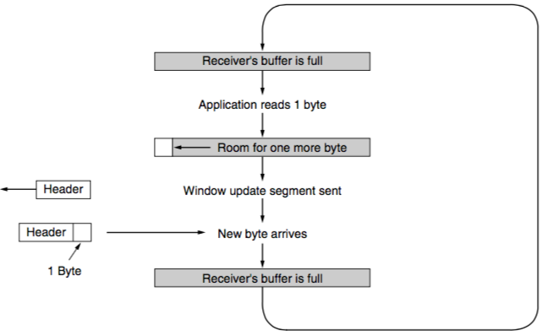
Silly Window Syndrome
Data are passed to the sending TCP entity in large blocks, but an interactive application on the receiver side reads data only 1 byte at a time. Basically what the mean is that the rate at which the sending buffer is being filled is very high, but the receiver rate at the receive buffer is very low. In this case, even though the sender HAS a lot of data to send, due to the absence of space in the receive buffer, it is forced to send multiple small packets, thereby causing us to reach the same impasse as before.
Clark’s solution: Do not send window update for 1 byte. Wait until sufficient space is available at the receiver buffer. ”Sufficiency” is network and implementation dependent.

Slide 24
Handling Short Segments – Sender and Receiver Together
Nagle’s algorithm & Clark’s solution to Silly Window syndrome are complementary
Nagle’s algorithm: Solve the problem caused by the sending application delivering data to TCP a byte at a time. Manages sending rate being less by buffering till sufficient data is available, and hence utilizes resources better.
Clark’s solution: Receiving application fetching the data up from TCP a byte at a time Manages receiver rate being less by delaying the window size advertisement, till a sufficient amount of data can be held in the receive buffer.
Exception: The PSH flag is used to inform the sender to create a segment immediately without waiting for more data

Slide 25
Handling Out of Order in TCP
TCP buffers out of order segments and forward a duplicate acknowledgement to the sender.
Acknowledgement in TCP – Cumulative acknowledgement
Receiver has received bytes 0, 1, 2, _, 4, 5, 6, 7
TCP sends a cumulative acknowledgement with ACK number 2, acknowledging everything up to byte 2
Once 4 is received, a duplicate ACK with ACK number 3 (next expected byte) is forwarded – triggers congestion control
After timeout, sender retransmits byte 3
Once byte 3 is received, it can send another cumulative ACK with ACK number 8 (next expected byte)

Slide 26
TCP Timer Management
TCP Retransmission Timeout (RTO): When a segment is sent, a retransmission timer is started
If the segment is acknowledged before the timer expires, the timer is stopped
If the timer expires before the acknowledgement comes, the segment is retransmitted
What can be an ideal value of RTO ?
Possible solution: Estimate RTT, and RTO is some positive multiples of RTT
RTT estimation is difficult for transport layer – why? Estimation of RTT at the Dynamic Transport Layer is difficult because there are too many factors to correctly estimate the time.

Slide 27
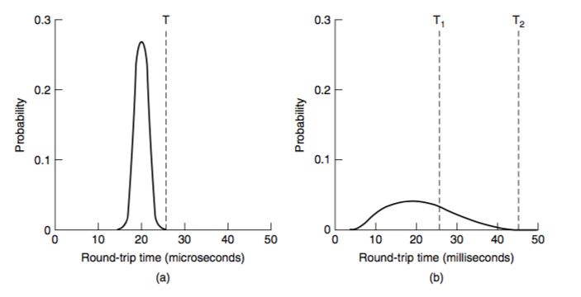
RTT at Data Link Layer vs RTT at Transport Layer
The ACK Arrival Time in case of the Data Link Layer is bound to be less variant as compared to the Transport Layer for the simple reason that the Data Links are between two adjacent routers in the Network, rather than two separate individual Networks all together.
The dynamicity between two entities which share a connection in the Data Link Layer is way less as compared to the Transport Layer. This is the reason why the variance in the RTT is so small as compared to the Transport Layer., where the multifold of external factors lead to a delay in the Transport Layer Segments
Data Link Layer
Transport Layer
For the DLL, choice of the RTT is fairly straightforward, however not so much for the Transport Layer. A Small RTO will lead to unnecessary retransmissions, and a high RTT would affect the performance because we would then drag each Timeout for RTT Amt of time.

Slide 28
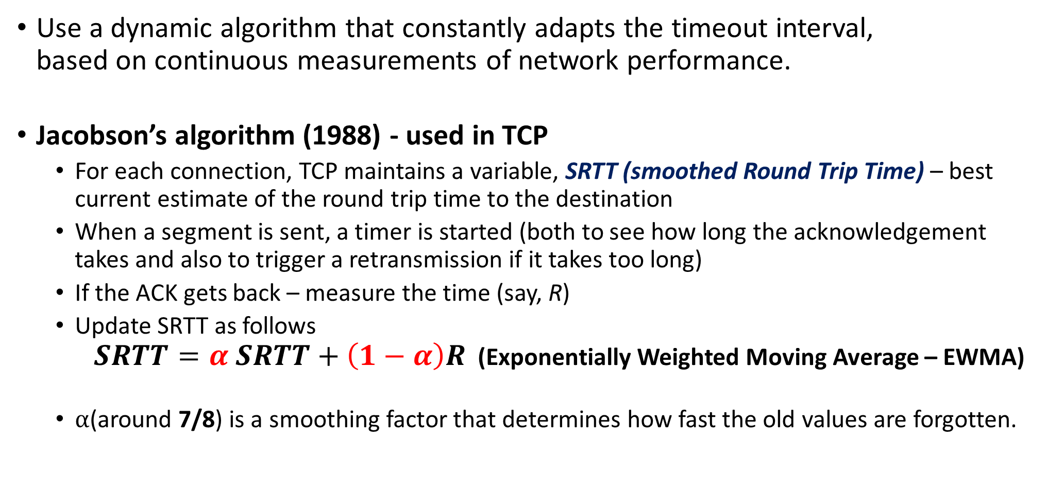
RTT Estimation at the Transport Layer
Use a dynamic algorithm that constantly adapts the timeout interval, based on continuous measurements of network performance.
Jacobson’s algorithm (1988) - used in TCP
For each connection, TCP maintains a variable, SRTT (smoothed Round Trip Time) – best current estimate of the round trip time to the destination
When a segment is sent, a timer is started (both to see how long the acknowledgement takes and also to trigger a retransmission if it takes too long)
If the ACK gets back – measure the time (say, R)
Update SRTT as follows $SRTT=α SRTT+\left(1−α\right)R$ (Exponentially Weighted Moving Average – EWMA)
⍺(around 7/8) is a smoothing factor that determines how fast the old values are forgotten.
Current Calc RTT
Current Act RTT

Slide 29
Problem with EWMA
Even given a good value of SRTT, choosing a suitable RTO is nontrivial.
Initial implementation of TCP used RTO = 2SRTT
Experience showed that a constant value was too inflexible, because it failed to response when the variance went up (RTT fluctuation is high) – happens normally at high load when load nearly reaches network capacity.
Jacobson suggested to consider variance of RTT as well during RTO estimation.

Slide 30
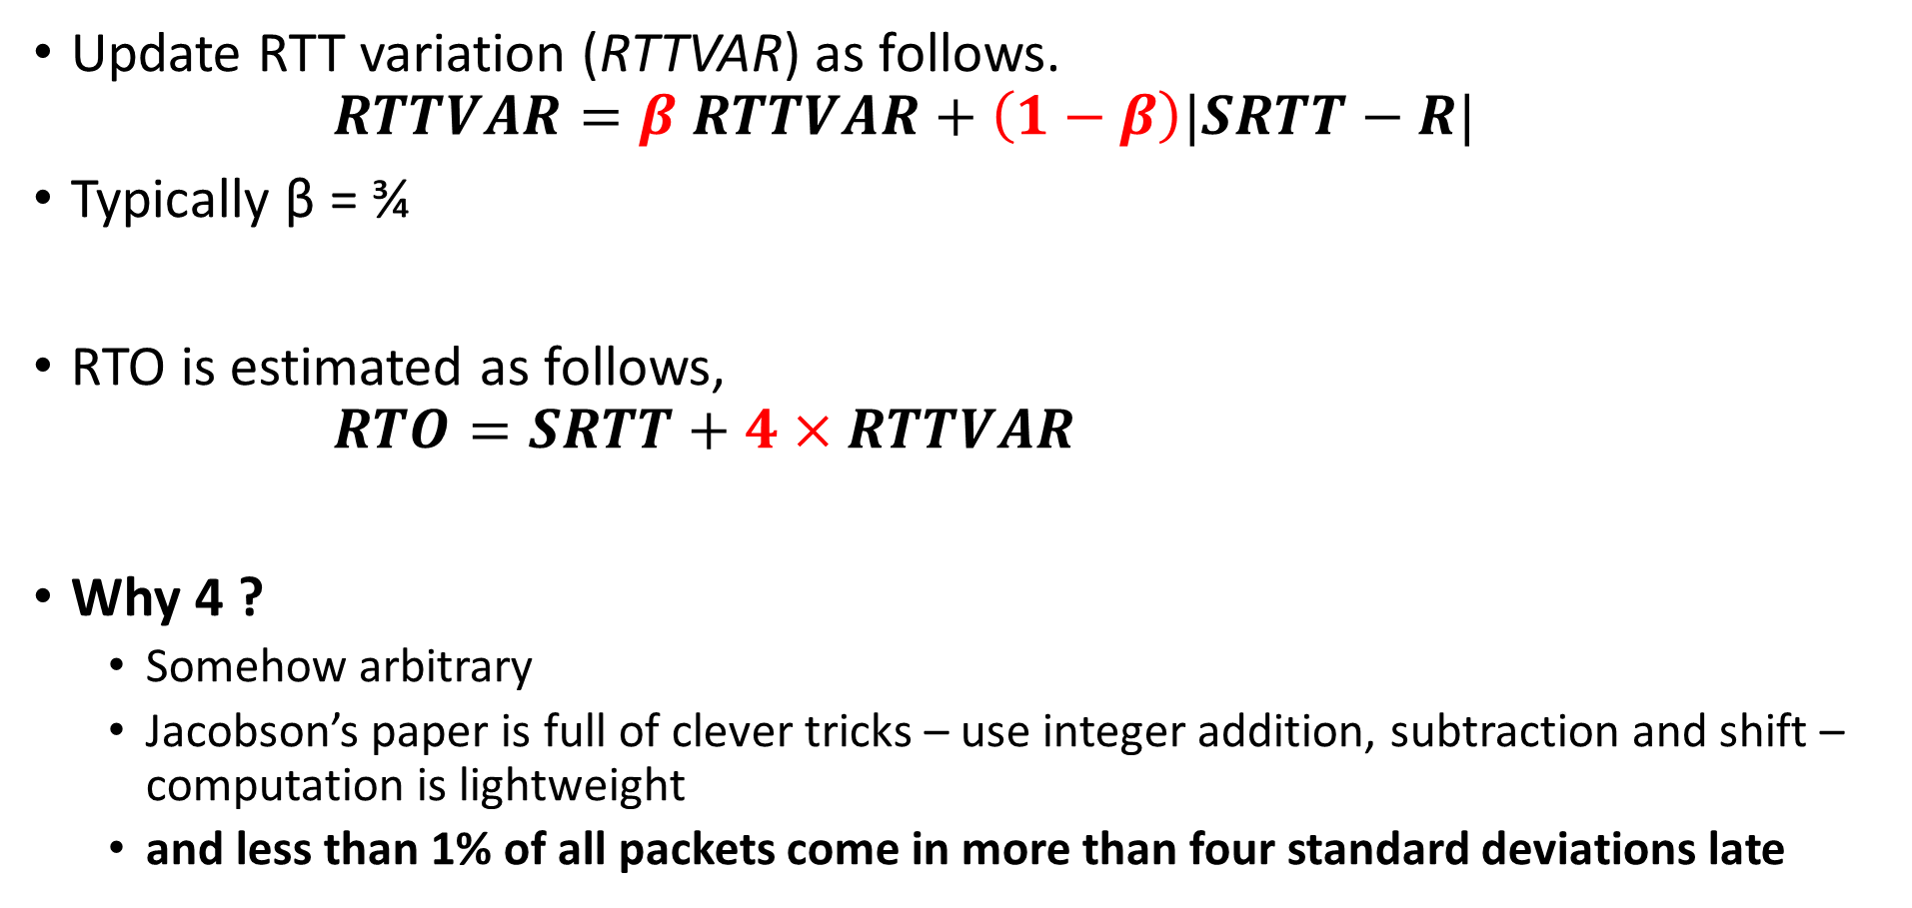
RTO Estimation
Update RTT variation (RTTVAR) as follows. $RTTVAR=β RTTVAR+\left(1−β\right)|SRTT−R|$
Typically β = ¾
RTO is estimated as follows, $RTO=SRTT+4×RTTVAR$
Why 4 ?
Somehow arbitrary
Jacobson’s paper is full of clever tricks – use integer addition, subtraction and shift – computation is lightweight
and less than 1% of all packets come in more than four standard deviations late
Current Calc Variance
Current Actual Variance

Slide 31
Karn’s Algorithm
How will you get the RTT estimation, when a segment is lost and retransmitted ? The problem basically is this that when an ACK comes, we do not know whether it is in response to the retransmitted segment that we sent or just a delayed reply of the previous to that packet or something even before. A wrong estimation may result in severe repercussions in the Moving Exponential Average of the SRTT.
Solution : Karn’s algorithm:
Do not update estimates on any segments that has been retransmitted
The timeout is doubled each successive retransmission until the segments gets through the first time

Slide 32
Other TCP Timers
Persistent TCP Timer: Avoid deadlock when receiver buffer is announced as zero
After the timer goes off, sender forwards a probe packet to the receiver to get the updated window size
KeepAlive Timer: Close the connection when a connection has been idle for a long duration
TCP TIME_WAIT: Wait before closing a connection – twice the packet lifetime

Slide 33
TCP Congestion Control
Based on implementation of AIMD using a window and with packet loss as the binary signal
TCP maintains a Congestion Window (CWnd) – number of bytes the sender may have in the network at any time :: Rate which Network can support. Kind of the number of UnACKed Segments in the Network at any instance
Sending Rate = Congestion Window / RTT
Sender Window (SWnd) = Min (CWnd, RWnd)
RWnd – Receiver advertised window size :: Rate which Receiver can support. FLOW CONTROL ALGORITHM provides us with this value.

Slide 34
1986 Congestion Collapse
In 1986, the growing popularity of Internet led to the first occurrence of congestion collapse – a prolonged period during which goodput dropped precipitously (more than a factor of 100) :: Need for Congestion Control Arises
Early TCP Congestion Control algorithm – Effort by Van Jacobson (1988)
Challenged for Jacobson – Implement congestion control without making much change in the protocol (made it instantly deployable) . This is because there were a decent number of systems in the worldwide network which made use of TCP as their protocol and if suddenly a new protocol was introduced, it would be a problem to make these machines work with them and issues of backward compatibility may arise.
Packet loss is a suitable signal for congestion – use timeout to detect packet loss. Tune CWnd based on the observation from packet loss (using AIMD ) At that time, the notion of wireless networking was nascent, most connections were wired and in general wired networks can be considered to be lossless. This meant that a packet loss would ONLY come from it being dropped from the network buffer at one of the intermediate devices due to overflow at these buffers -> CONGESTION.

Slide 35
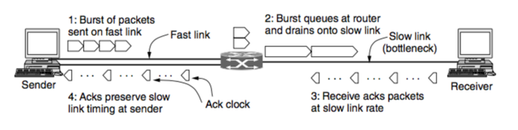
Adjust CWnd based on AIMD
One of the most interesting ideas – use ACK for clocking
ACK returns to the sender at about the rate that packets can be sent over the slowest link in the path. This is so much like an RDS of the connection. We use the ACK Rate to estimate the RDLink perhaps.
Trigger CWnd adjustment based on the rate at which ACK are received.

Slide 36
Increase Rate Exponentially at the Beginning – The Slow Start
AIMD rule will take a very long time to reach a good operating point on fast networks if the CWnd is started from a small size.
A 10 Mbps link with 100 ms RTT
Appropriate CWnd = BDP = 1 Mbit
1250 byte packets -> 100 packets to reach BDP
CWnd starts at 1 packet, and increased 1 packet at every RTT
100 RTTs are required 10 sec before the connection reaches to a moderate rate
Slow Start - Exponential increase of rate to avoid slow convergence
Rate is not slow at all ! 😃
CWnd is doubled at every RTT

Slide 37
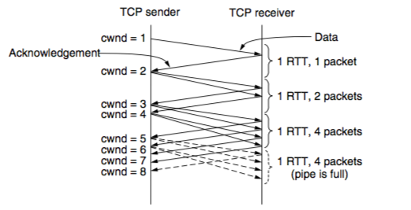
TCP Slow Start
Every ACK segment allows two more segments to be sent, size increase of one segment takes place for each ACK which is received.
For each segment that is acknowledged before the retransmission timer goes off, the sender adds one segment’s worth of bytes to the congestion window. And since it has returned too, we have space for 2 Segments more for each ACK Effectively Doubling the CWnd Size.

Slide 38
Slow Start Threshold
Slow start causes exponential growth, eventually it will send too many packets into the network too quickly.
To keep slow start under control, the sender keeps a threshold for the connection called the slow start threshold (ssThresh).
Initially ssThresh is set to BDP (or arbitrarily high) – max possible flow in network
Whenever a packet loss is detected by a RTO : ssThresh is set to be ”½ of CWnd” Thought behind this is that, this current value of ssThresh caused a packet loss, but nothing as such was detected when the CWnd was half of it, so we set the ssThresh to be half of the CWnd which is now the new safe value of the Threshold, and the CWnd is then set to a small initial value and SLOW START starts again.

Slide 39
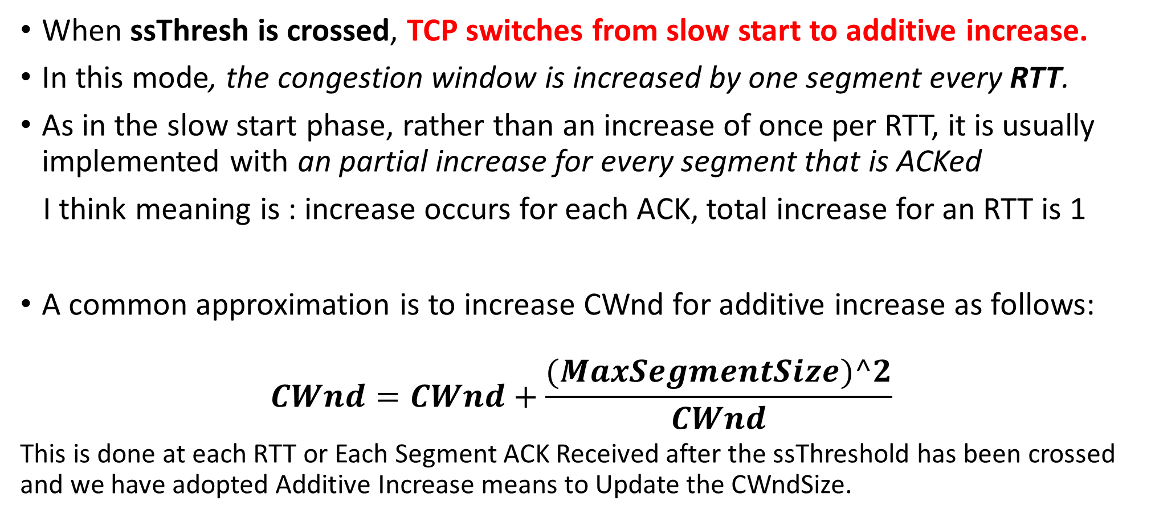
Additive Increase (Congestion Avoidance)
When ssThresh is crossed, TCP switches from slow start to additive increase.
In this mode, the congestion window is increased by one segment every RTT.
As in the slow start phase, rather than an increase of once per RTT, it is usually implemented with an partial increase for every segment that is ACKed
I think meaning is : increase occurs for each ACK, total increase for an RTT is 1
A common approximation is to increase CWnd for additive increase as follows:
$$CWnd=CWnd+\frac{(MaxSegmentSize)^2}{CWnd}$$
This is done at each RTT or Each Segment ACK Received after the ssThreshold has been crossed and we have adopted Additive Increase means to Update the CWndSize.

Slide 40
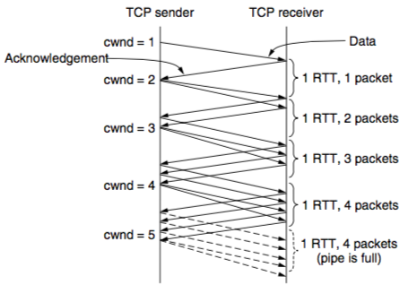
Additive Increase – Packet Wise Approximation
At the end of every RTT, the sender’s congestion window has grown enough that it can inject an additional packet into the network.
This growth which we are talking about happens at each Segment ACK.
In case a packet loss occurs, the ACK will be stuck at a particular segment’s sequence number, and hence there will no growth of the congestion window size, it will remain full and basically there will be a starvation till the RTO times out and the Packet Loss is ReTransmitted.
So we need an EARLY NOTION of Congestion Detection so that we do not end up starving for the RT.

Slide 41
Triggering an Congestion
Two ways to trigger a congestion notification in TCP – (1) RTO, (2) Duplicate ACK
RTO: A sure indication of congestion, however time consuming This indicates very severe congestion in the network and drastic drop in CWnd is required to rectify this situation.
Duplicate ACK: Receiver sends a duplicate ACK when it receives out of order segment
A loose way of indicating congestion ( 1 dupACK may arise due to different route of two packets )
TCP arbitrarily assumes that THREE duplicate ACKs (DUPACKs) imply that a packet has been lost – triggers congestion control mechanism
The identity of the lost packet can be inferred – the very next packet in sequence
Retransmit the lost packet and trigger congestion control

Slide 42
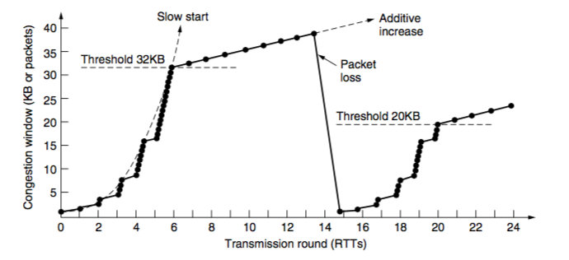
Fast Retransmission – TCP Tohoe
Use THREE dupACK as the sign of congestion This is not really a very severe indication of congestion in the network.
Once 3 dupACK have been received,
Retransmit the lost packet (fast retransmission) – takes one RTT
Set ssThresh = (0.5)*CWnd
Set CWnd = 1 MSS

Slide 43
Fast Recovery – TCP Reno
Once a congestion is detected through 3 DUPACKs, do TCP really need to set CWnd = 1 MSS ?
DUPACK means that some segments are still flowing in the network – a signal for temporary congestion, but not a prolonged one
This is not really a very severe indication of congestion in the network. Just that one particular Packet got dropped, but since we are receiving the dupACK it means that the other Subsequent Packets are reaching the Receiver Side so the Packets are still moving decently in the Network, we just need to perform a minor check to the CWnd Size.
Immediately transmit the lost segment (fast retransmit), then transmit more segments based on the DUPACKs received (fast recovery) We retransmit the lost segment and then till we await the newACK from arriving, the dupACKs keep on coming; some from the Packets we sent after the Lost one and before we detected 3 dupACKs.

Slide 44
Fast Recovery – TCP Reno
Fast recovery:
set ssThresh to one-half of the current congestion window. Retransmit the missing segment.
set CWnd = ssThresh + 3.
Each time another duplicate ACK arrives, set CWnd = CWnd + 1. Then, send a new data segment if allowed by the value of CWnd .
Once receive a new ACK (an ACK which acknowledges all intermediate segments sent between the lost packet and the receipt of the first duplicate ACK), exit fast recovery. This causes setting CWnd = ssThresh (the ssThresh in step 1). And continue with linear increasing due to congestion avoidance algorithm.
If no new ACK arrives, again something has occurred to that packet, probably this time RTO will take care of it.

Slide 45
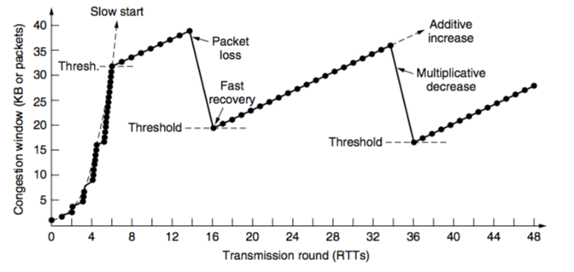
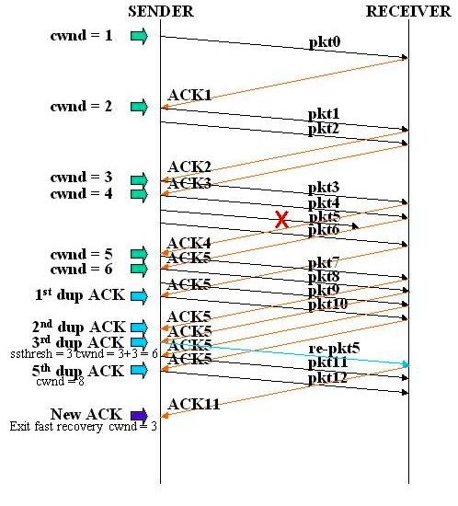
Fast Recovery – TCP Reno

Slide 46
This is a broad discussion of the Transport Layer … Next we’ll move to the discussion of Network layer and the IP Protocol

